Slide 1







28th Meeting of the Steering Group of EUSDR PA 10
14-15 may 2025, sarajevo

Slide 2
Priorities, short reminder
Speeding up the European integration process;
Brain-drain, the widening skills gap, depopulation, youth unemployment.

Slide 3
Thematic priorities
Security, civil protection and disaster preparedness;
Tourism and culture;
Connectivity and green transition;
Education, skills and labour market.

Slide 4
Thematic priorities (2)
Contribution to the SDG UN Agenda 2030 and South East Europe 2030 Strategy;
Gender equality;

Slide 5

Thematic events/meetings, completed so far
EUSDR PAC Meeting, Sarajevo, 26-27 February,
Joint event of Bosnian and Herzegovinian 2025 EUSDR Presidency, the Republic of Croatia, PA 5, PA 10 (RCC, ICPDR). Enhancing regional cooperation in the Danube basin: Stronger Together, Mostar 3 April;

Slide 6
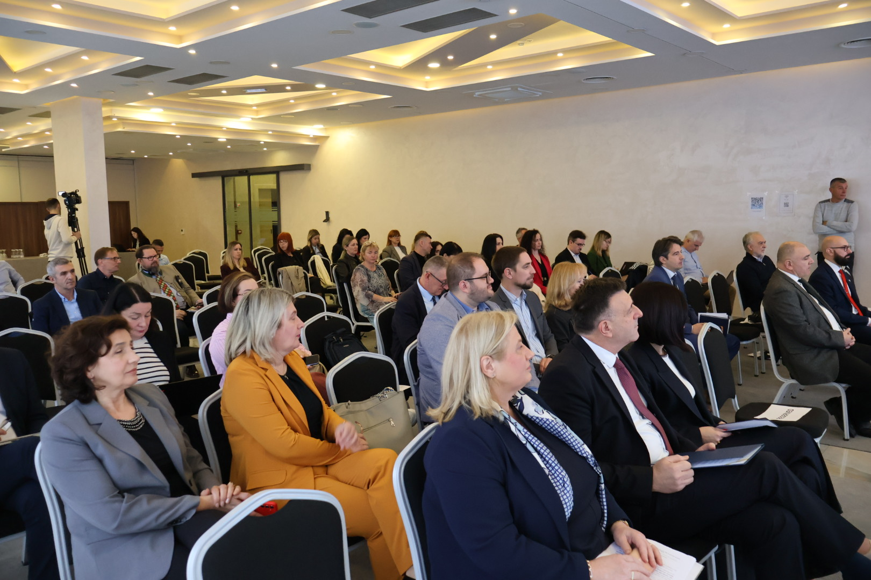
MOSTAR 3 April 2025

Slide 7
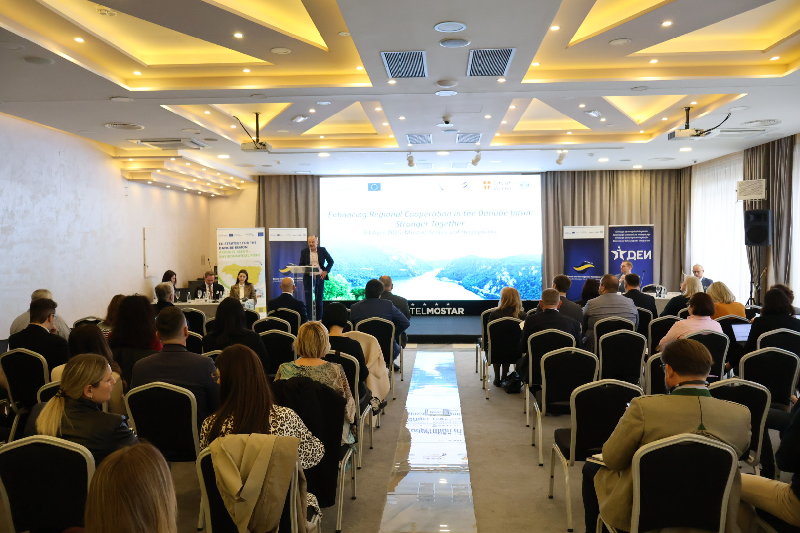
MOSTAR 3 April 2025

Slide 8
Thematic events/meetings, completed so far (2)
EUSDR Joint NC Meeting (+TRIO PCY Meeting), Sarajevo, 9-10 April;
National Participation Day, PA 10, Danube Civil Society Forum, LDA Mostar, supported by the PCY, 13 May, Sarajevo;

Slide 9
Thematic events/meetings before the AF, other
PA 10 SG Meeting, 14-15 May, Sarajevo;
PA 1b SG Meeting, 4 June, Sarajevo;
Enhancing Railway Connectivity and Interoperability in the Danube Region, cooperation with PA 1b, 5 June, Sarajevo;
NC-PAC (+TRIO PCY), (9)10-11 September, Sarajevo;
17th HLG Meeting and 9th Meeting of 4 MRS TRIO Presidencies, Bruxelles, 26 September.

Slide 10
Thematic events/meetings, confirmed so far, to be organised before the AF(2)
Energy - regional interconnections development, optimisation of the renewable sources of energy, regional market, storing, implementation of the ETS system and CBAM. Partner: Ministry of Foreign Trade and Economic Relations (MoFTER) of Bosnia and Herzegovina. Event included in Sarajevo Energy and Climate Week (SECW 2025), last week of September;
Conference: Implementation of the UN SDGs in Danube Region, partners: MFA, UN BiH Office, BiH Working group for SDGs, October 2025;

Slide 11
Events organised in cooperation with other organisations
The events in organization of the RCC and DRC, exact dates expected.

Slide 12
Institutional goals
stronger involvement of the EU Commission’s DG ENEST and related line DGs in the implementation of the EUSDR;
supporting the upcoming processes towards the new Cohesion Policy and further enhancing the process of embedding of EUSDR into EU funding mechanisms and thus laying ground for availability of funding sources needed for the implementation of the EUSDR beyond 2027. Special attention will be paid to actions in connection with next IPA and NDICI planning and programming;
exploring the opportunities arising from the new Growth Plan for the Western Balkans that can potentially contribute to the accelerated implementation of the EUSDR.

Slide 13
Cooperation with other MRSs
Since five EUSDR member states participate in the implementation of the EU Strategy for the Adriatic-Ionian Region (EUSAIR) special attention will be on cooperation with that Strategy;
Participation at the panel „Contribution of EU Macro-Regional Strategies to EU Enlargement“, Mediterranean Coast and MRSs Week 2025, Izola, 16 September;
Joint meeting of the EUSDR + EUSAIR NCs, DG Regio, governance support projects, Mas IPA Adrion and DRP (6 November)

Slide 14
Thank you for your attention
14th Annual Forum of the EU Strategy for the Danube Region (EUSDR)
Sarajevo, (4), 5-6 November 2025
THE PROPOSALS OF THE EVENTS FROM THE PACs RECEIVED

