Slide 1
3rd CfP Thematic Seminar Specific Objective 4.1. Well Governed Danube Region SK National Info Day
15th January 2019, Bratislava

Slide 2
Agenda
9.30
DTP Framework
Main Elements 3rd Cfp
(joint session)
10.45
Coffee Break
Thematic Seminar S.O. 4.1
SK National Info Day
11.15
4.1-topics already addressed
Good practice example
Overview on all S.O.s and topics addressed under 3rd CfP
12.00
Lunch Break
13.00
Topics at focus under 3rd CfP
EUSDR PAC inputs
General requirements for successful project application
14.00
Coffee Break
14.15
Joint Brokerage Session
Networking and targeted info-exchange
16.00

Slide 3
DTP
General framework
Main Elements 3rd CfP

Slide 4
DTP General Framework
DTP Mission
DTP 2014-2020 acts as a policy driver and pioneer to tackle common challenges and needs in specific policy fields where transnational cooperation is expected to deliver tangible results

Slide 5
DTP General Framework
DTP and EUSDR
Identical geographical scope, but the DTP is a (focused) funding instrument and the EUSDR a (wide) strategic framework
The DTP is one funding instrument supporting the EUSDR
all DTP S.O. are relate to one or more PAs of the EUSDR
… but not the only one

Slide 6
DTP General Framework
DTP is NOT:
A Programme addressing Danube riparian areas only!
A Programme for big infrastructure!
A research Programme!
A Programme aiming at mere networking!
A Programme for initiatives which could be better funded by other instruments

Slide 7
DTP General Framework
Innovative and socially responsible Danube Region 1.1: Improve framework conditions for innovation 1.2: Increase competences for business and social innovation
Environment and culture responsible Danube Region 2.1: Strengthen transnational water management and flood risk prevention 2.2: Foster sustainable use of natural and cultural heritage and resources 2.3: Foster the restoration and management of ecological corridors 2.4: Improve preparedness for environmental risk management
Better connected and energy responsible Danube Region
3.1: Support environmentally-friendly and safe transport systems and balanced accessibility of urban and rural areas 3.2: Improve energy security and energy efficiency
Well governed Danube Region 4.1:Improve institutional capacities to tackle major societal challenges 4.2: Support the governance and implementation of the EUSDR

Slide 8
3rd CfP – Main elements
Addressed priorities and specific objectives under 3rd CfP
Innovative and socially responsible Danube Region
Environment and culture responsible Danube Region
Better connected and energy responsible Danube Region
Well governed Danube Region
SO 4.1 OPEN
SO 2.1
SO 2.2 OPEN
SO 2.3 OPEN
SO 2.4 OPEN
SO 1.1
SO 1.2
SO 3.1
SO 3.2 OPEN
Opening of SO 4.1 is subject to approval of the programme budget reallocation by the EC

Slide 9
3rd CfP – Main elements
3rd Call for Proposals
To be launched soon!
Two step approach:
1st step: submission of a short Expression of Interest
(and if successful)
2nd step: submission of a complete Application Form
Call budget: up to 60M EUR (ERDF, IPA, ENI)
Max project duration: 30 months

Slide 10
3rd CfP – Main elements
Budget* of the 3rd Call for Proposals in EUR
* All amounts in the table are subject to MC approval.
PA | ERDF | IPA | ENI MD | ENI UA | Total
PA1 | 13,463,630.97 | 795,801.87 | 594,479.00 | 648,471.95 | 15,502,383.79
PA2 | 16,460,009.81 | 974,337.27 | 743,098.00 | 810,590.70 | 18,988,035.78
PA3 | 11,068,880.71 | 671,049.92 | 520,168.50 | 567,413.00 | 12,827,512.13
PA4/SO4.1 | 9,918,396.26 | 858,974.77 | 625,000.00 | 625,000.00 | 12,027,371.03

Slide 11
3rd CfP – Main elements
Information for applicants / official launch
Official launch beginning of 2019
BUT “Application pack” already available:
Applicants Manual
EoI templates
Guidelines for EoI
http://www.interreg-danube.eu/calls/calls-for-proposals/third-call-for-proposals

Slide 12
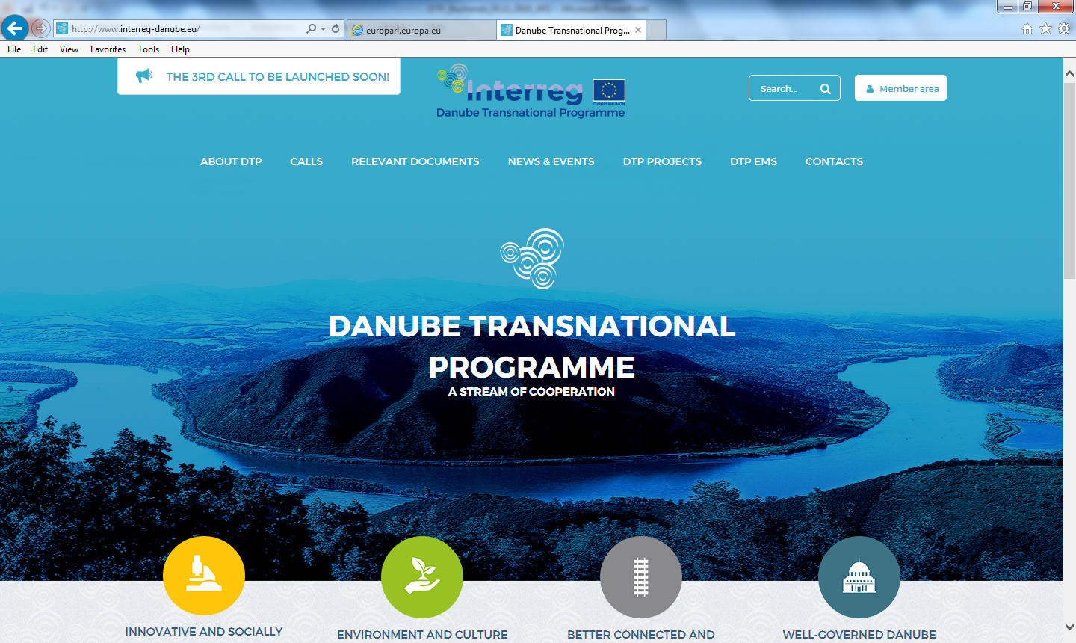
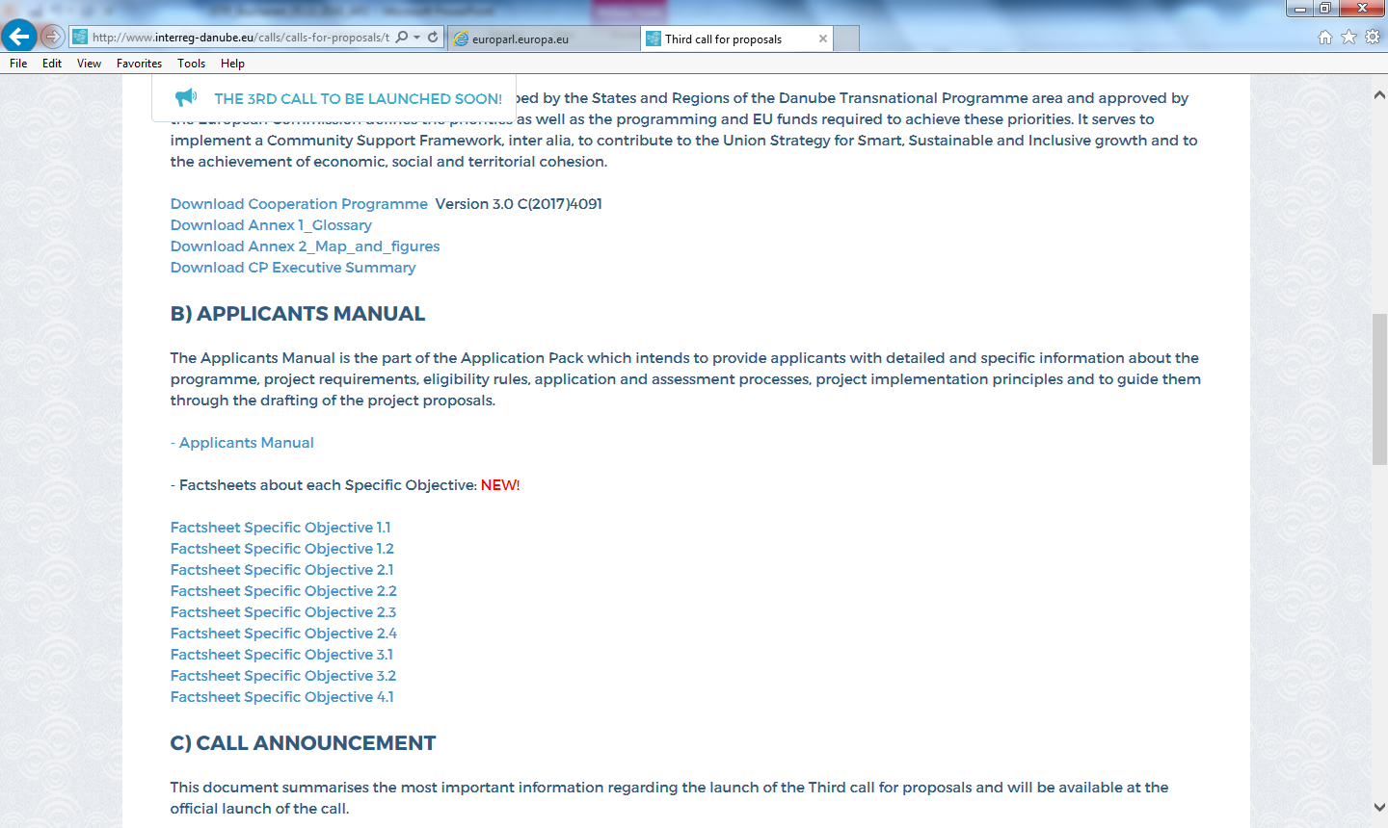
3rd CfP – Main elements

Slide 13
3rd CfP – Main elements
1. Staff cost
Real cost OR
Flat rate (up to 20% of the direct cost)
2. Office and admin.
Flat rate (15% of staff cost)
3. Travel & accommodation
4. External expertise & services
5. Equipment
6. Infrastructure & works

Slide 14
3rd CfP – Main elements
Additional Information and Advice
National Info Days / National Info Points
Thematic Seminars
Bilateral consultation with JS Project Officers
Approach JS PO with “Concept Note” (asap)
Arrange bilateral consultation (in Budapest or by phone)

Slide 15
IVY initiative
Promote solidarity & cooperation with IVY volunteers
Interreg Volunteer Youth is part of the European Solidarity Corps
AEBR helps with pre-selection of volunteers and covers financial support for the volunteer
More info: interregyouth.com

Slide 16
Specific Objective 4.1
General Scope
Topics already addressed
Good Practice Example

Slide 17
S.O. 4.1. – General Scope
Governance: main findings during DTP programming
Cooperation-gaps across borders and between different governmental levels, sectoral policies, governmental and non-govern. organizations
Lack of institutional capacities to respond to main societal challenges
Severe discrepancies in governance performance
Weak involvement of civil society in policy development and decision making
Very high administrative fragmentation of the Danube Region

Slide 18
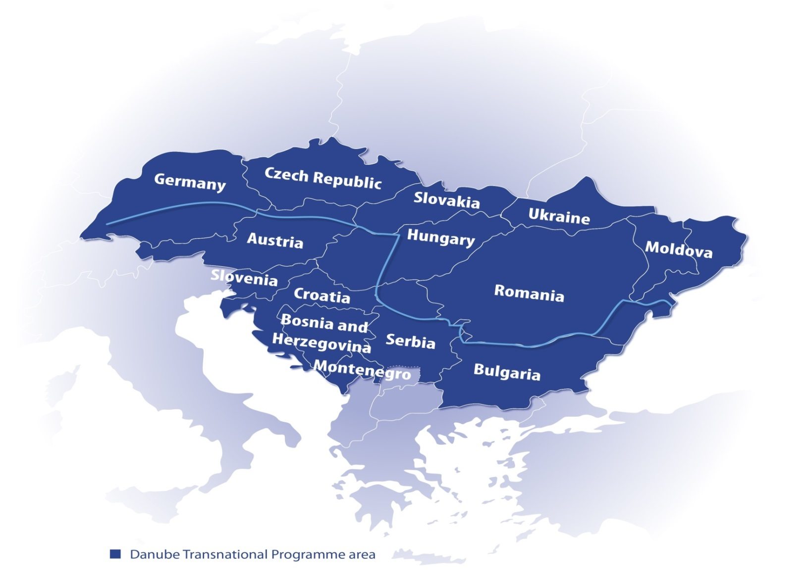
S.O. 4.1. – General Scope
Governance Challenges in the Danube Region

Slide 19
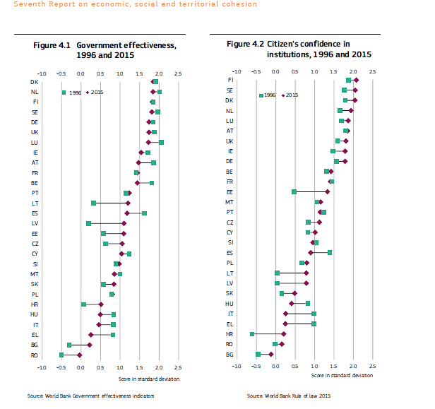
S.O. 4.1. – General Scope
Governance Challenges
In the Danube Region
Notes:
Definition: The index of Government Effectiveness captures perceptions of the quality of public services, the quality of the civil service and the degree of its independence from political pressures, the quality of policy formulation and implementation, and the credibility of the government's commitment to such policies.

Slide 20
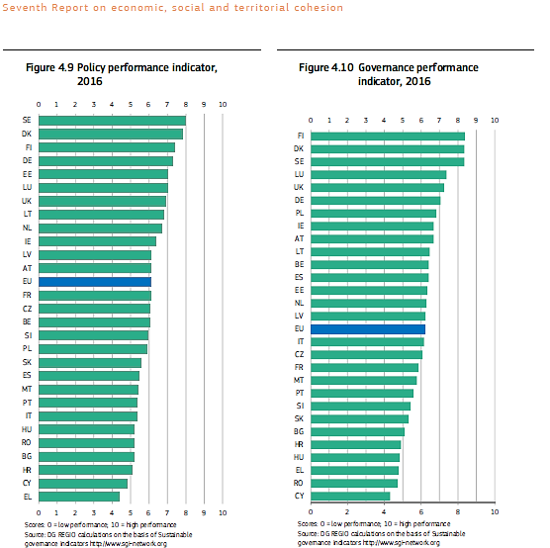
S.O. 4.1. – General Scope
Governance Challenges
In the Danube Region
Notes:
Sgi-network.org
Policy performance: Do economic policies address sustainability challenges? Do social policies facilitate an equal and fair society? Do environmental policies address sustainability issues?
Policy performance: Does the government have strong steering capabilities? Are non-governmental actors involved in policy-making?

Slide 21
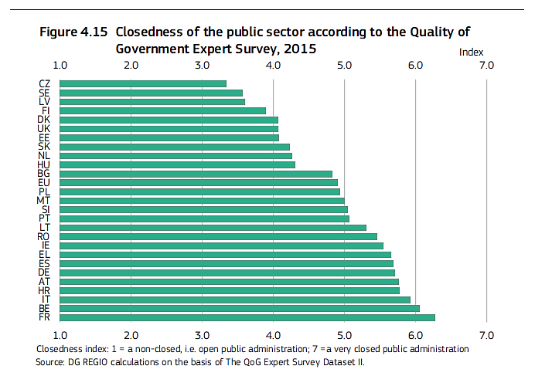
S.O. 4.1. – General Scope
Governance Potentials in the Danube Region
Notes:
Open HR systems are characterised by a rather position-related recruitment, open access to public service and greater exchange and mobility with the private sector, whereas in closed systems external entry to the system is restricted

Slide 22
S.O. 4.1. – General Scope
Expected Results according to original Cooperation Programme
Improved capacities of public institutions and stakeholders to tackle major societal challenges in fields such as
Demographic change and migration
Inclusion of vulnerable and marginalized groups, esp. Roma communities
Labour market policies, education systems & policies
Participatory planning processes and involvement of civil society
Urban-rural cooperation and partnership
Cooperation on safety, justice and security

Slide 23
S.O. 4.1. – General Scope
Framing Governance and institutional capacity
Multi-level governance: “The set of institutional arrangements which regulate the mutually dependent relationships (vertical, horizontal, or networked) between public, private and societal actors.”
European Commission, 2012
“Institutional capacity is not just a technical matter of training civil servants. It relates to how public authorities interact with and deliver services to business and citizens.”
European Commission, 2014

Slide 24
S.O. 4.1. – Topics funded so far
Edu Lab
Learning by Doing
Danube Skills
Education
Systems
AgriGo4Cities
ATTRACTIVE DANUBE
Participation
RARE
Demographic Change
DRIM
YOUMIG
Inclusion

Slide 25
S.O. 4.1. – Topics funded so far
Educational Governance
Edu Lab (European Foundation for Education / DE)
Improving institutional capacities to increase the labour-market relevance of higher education with a view to retain more young talents studying and working in the Danube region
Learning by Doing (Budapest Chamber of Commerce)
Developing transnational tools to support long term transition of VET systems and developing strategies describing transition of VET systems
Danube Skills (Romanian Maritime Training Centre – CERONAV)
Increasing institutional capacity in Danube navigation by boosting joint transnational competences and skills in education and public development services

Slide 26
S.O. 4.1. – Topics funded so far
Demographic Change / Migration
DRIM
Improving the capacity of public institutions to respond to the needs of newly arrived as well as resident migrants through effective information sharing (“Danube Compass”)
YOUMIG
Boosting the institutional capacities of local governments to enhance the scarce local evidence on youth migration, contributing to improved policymaking with a focus on human capital

Slide 27
S.O. 4.1. – Topics funded so far
Participation / Inclusion
AgriGo4Cities
Participatory (Peri-)Urban Agriculture (UPA) for improving institutional capacities in order to tackle socio-economic exclusion of vulnerable groups and to stimulate sustainable urban development
ATTRACTIVE DANUBE
Strengthening multilevel and transnational governance and institutional capacities of policy by establishing a perma­nent common transnational platform for monitoring territorial attractiveness
RARE
Enhancing the capacities of and cooperation among actors having a stake in the labour market participation of the Roma in order to better exploit their economic potential

Slide 28
S.O. 4.1. – Topics funded so far
Good Practice Expample: DRIM

Slide 29
S.O. 4.1
Topics covered by 3rd CfP
EUSDR Inputs

Slide 30
S.O. 4.1. – 3rd CfP focus
Expected Results according to original Cooperation Programme
Improved capacities of public institutions and stakeholders to tackle major societal challenges in fields such as
Demographic change and migration
Inclusion of vulnerable and marginalized groups, esp. Roma communities
Labour market policies, education systems & policies
Participatory planning processes and involvement of civil society
Urban-rural cooperation and partnership
Cooperation on safety, justice and security

Slide 31
S.O. 4.1. – 3rd CfP focus
Highlighted topics under 3rd CfP
(not replacing or limiting the original scope of S.O. 4.1 but complementing and specifying it for avoiding duplications)
Education: Stronger focus on increasing the educational attainment, recognition of skill-level across borders and provision of educational services for vulnerable / marginalised groups
Migration: stronger focus on labour market implication, inclusive approaches regarding specific target groups (e.g. woman, low skilled) and service provision (e.g. health care or housing);
Labour market policies: stronger focus on youth and access to quality employment for specific target groups (e.g. youth, elderly, woman, vulnerable groups).
Active citizenship and sustainable democracy

Slide 32
S.O. 4.1. – 3rd CfP focus
Key points to consider when applying under S.O.4.1
Definition of a thematic niche in clear relation to one or more of the governance bottlenecks identified by the Programme
Demonstration or transnational, Danube-specific needs or challenges
Clear multi-level governance set-up across sectors (public – private – civil) and administrative levels (national – regional – local)
Demarcation from other S.O.s (esp. 1.1 and 1.2) and ensuring complementarity and capitalization in view of existing results
Alignment of proposal to the EUSDR (esp. PA 09, 10, 11)

Slide 33
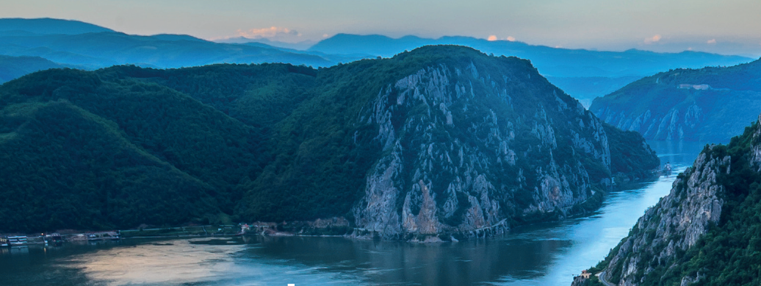
www.interreg-danube.eu

