Slide 1
EBRD support
to private enterprises in Serbia
24 January 2013
2nd Danube Financing Dialogue
National Bank of Serbia

Slide 2
EBRD in Serbia
Country of operation since 2001
Total cumulative commitments of € 3.11bn as of Dec 2012
Private sector participates with 45% in total cumulative commitments
Total outstanding portfolio of € 2.34bn, comprised of 123 active operations
In 2012, invested € 270 million in 20 projects
In 2013, plan to invest € 300 million in 20 projects or more
Team of 22 people in Resident Office in Belgrade
Objectives: To promote a sound investment climate, good corporate governance and stronger institutions

Slide 3
SME Financing Provided Through Credit Lines to Local Banks
Improve access to longer term finance for private enterprises for urgent capital investments, as well as working capital;
Facilitate upgrades of SME operations towards EU production standards;
Promote sustainability and competitiveness of the SME sector through crisis and beyond;
Capacity building at the level of participating banks to assess and finance environmental investments.

Slide 4
What is LEF?
Local Enterprise Facility
Size of investments: LEF individual investment could amount up to €10m
Established jointly by the EBRD and the Italian Government in 2006
A delegated facility for equity, quasi-equity investments and tailor-made debt financing
Investment region encompasses Western Balkans, Turkey, Bulgaria and Romania
Developed to support financing needs of dynamic local enterprises

Slide 5
Key LEF Objectives
Enhancing competitiveness and product quality by strengthening market competitiveness and improving the quality of goods and services provided
Restructuring by introducing new, replicable products and technologies to achieve better use of labour, higher productivity and efficiency improvements
Setting standards for corporate governance by encouraging investee companies to apply higher standards of corporate governance and business conduct

Slide 6
EBRD fosters entrepreneurship by providing business expertise in addition to financing
EBRD’s Small Business Support (SBS) has been helping Micro, Small and Medium sized Enterprises (MSMEs) since 1993
2 instruments: the Enterprise Growth Programme (EGP) and Business Advisory Services (BAS)
Run on a not-for-profit basis with donor funding in 24 countries
SBS at a glance
Over €200m donor funding
1,970 EGP projects
11,700 BAS projects
Over 750 market development activities
Notes:
6
Change with the one for ETC

Slide 7
EGP brings international know how, whilst BAS fosters local expertise
EGP supports the introduction of international best practice in small and medium-sized enterprises with the potential of becoming future leaders in their market through the placement of international advisors with at least 15 years of professional experience and expertise in the specific business sector.
BAS assists individual enterprises to engage with local consultants on a cost sharing basis through narrowly-based, specific projects with a rapid payback. It also directly increases the supply and quality of local advisory services, through targeted market development activities, to create a sustainable market of support for the small business sector.
Notes:
7
Shorten or make in bullet points

Slide 8
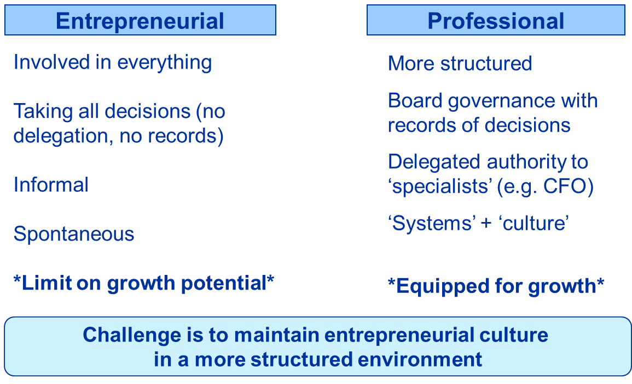
Transition from Entrepreneurial to a Professional Company

Slide 9
EGP and BAS in Serbia
EGP
Started in 2001
Over 180 projects, 3 ongoing
Funded by EU, Italy, Austria, Denmark, UK, Taipei China
Key sectors – wood processing, textile, chemical, electrical equipment, food processing
66.7% reported increase in turnover
EBRD investments over 10 mio EUR
BAS
Started in 2006
380 projects projects, 26 ongoing
Funded by the Netherlands, EU, EBRD, Taipei China
All sectors, leading – food and beverages, metals and machinery
67% BAS clients reported increase in turnover, 34% have attracted investment, over 2/3 continue using consultancy
Notes:
9
Shorten or make in bullet points

Slide 10
Challenges faced by SME
Access to finance
Lack of attention to strategic planning and strategic management, including need to reconsider business strategies to maintain or improve market position
Low interest in new forms of business co-operation in production, trade, technology, training, export services
Limited management skills and experience among owners of SME (weakest points: marketing, sales and strategic management)
Lack the motivation or knowledge to delegate effectively/lack of middle management
Limited ability of evaluating own problems and defining needsLimited ability to comply with European standards, which hinders competitiveness
Limited usage of: IT services, market research, forming of new channels for sales or implementation of new technologies
Lack of business information about foreign markets

Slide 11
Challenges faced by SME
- Outdated technology and limited automation of manufacturing process, insufficient level of innovations
- Low manufacturing of products with added value – paying attention to raw materials or semi-finished products
- Very low experience and limited interest among SME to self-organization in Associations, Clusters etc.
- Limited experience in lobbying techniques
-Lack of awareness of alternative sources of finance such as private equity, venture capital, business angels etc.

Slide 12
Challenges faced by SME
Weak balance sheet structure:
(i) predominance of short-term loans;
(ii) financing long-term needs with short-term funds;
Lack of financial expertise, information and corporate governance; Lack of financial planning and good financial management
Mixing up of different businesses – lack of focus by some entrepreneurs
Owner/owners don't want to give up any equity to a third party - conservative expansion plans financed mostly from own funds and loans;
Lack of well-prepared business plans

Slide 13
Contact Information
European Bank for Reconstruction and Development
Bulevar Zorana Djindjica 64a
11070 Novi Beograd
Serbia
Tel: +381 11 21 20 530
Fax: +381 11 212 0534

