Slide 1
EUSDR Priority Area 10 “Institutional Capacity and Cooperation” Webinar:Funding for civil society and local actors – an overview
4 December 2019

Slide 2
Agenda
Duration | Content
10 minutes | Civil Society and Local Actors in the Danube Region
40 minutes | EU Programmes
10 minutes | Development Cooperation
5 minutes | Foundations
10 minutes | Supporting Tools
10 minutes | Q & A
5 minutes | Wrap Up & Closure

Slide 3
Civil Society and Local Actors in the Danube Region

Slide 4
Civil Society & Local Actors in the Danube Region
⓪
①
①
⓪

Civil society organisations and local actors…
ensure ‚bottom-up‘ perspective of regional development
are key players for inclusive regional development
are key implementers of European“ policies
are bringing Europe and the Danube Region closer to the citizens
①
⓪
①
⓪
①
⓪


①
⓪
Advocacy
e.g. Representation of minorities
Service delivery
Strategic planning
Local Policy
Policy Dimensions
of Civil Society
Policy Dimensions
of Civil Society
Function
e.g. service delivery
e.g. ‚watch dog‘ function
e.g. Community building

Slide 5
Initial Thoughts towards Funding
Civil Society Organisations
Government bias vs. ‚Mission drift‘
Local & regional administrations
Innovative capacities
Need to Diversify

Slide 6
Funding Landscape
What we think it looks like…
What it actually looks like…

Slide 7

Funding sources
Public & Private Foundations
Development
Cooperation
EU Programmes
International Funding Programmes
National Funding
& many more

Slide 8

Structuring funding sources
EU membership status
Size of organisation (staff, budgets)
Type of project
②

EU member
Big organisations
Knowledge exchange
②

Non-EU member
Small organisations
Capacity building


Type of organisation
Knowledge & capacities
Project preparation


Local/regional authority
High capacities
☑
Project implementation
①

⓪
①
Civil society organisation
Low capacities
⓪

Slide 9
EU Programmes

Slide 10
EU Funding Programmes and Financing Instruments
Aid programme for the Turkish Cypriot community
Asylum and Migration Fund
Civil Protection and European Emergency Response Centre (ERC)
Civil Protection Mechanism
Cohesion Fund
Common Foreign and Security Policy (CFSP)
Competitiveness of Enterprises and SMEs (COSME)
Connecting Europe Facility
Consumer protection
Creative Europe
Customs, Fiscalis, and Anti-fraud
Erasmus +
Environment and Climate Action (LIFE)
Europe for Citizens
European Agricultural Fund for Rural Development (EAFRD)
European Agricultural Guarantee Fund (EAGF) — Market related Expenditure and Direct Payments
European Earth Observation Programme (Copernicus)
European Globalisation Adjustment Fund (EGF)
European Instrument for Democracy and Human Rights (EIDHR)
European Maritime and Fisheries Fund
European Neighbourhood Instrument (ENI)
European Regional Development Fund
European Satellite Navigation Systems (EGNOS and Galileo)
European Social Fund (ESF)
European Solidarity Corps
European Structural and Investment Funds
European Union Programme for Employment and Social Innovation (EaSI)
European Union Solidarity Fund
European Voluntary Humanitarian Aid Corps EU Aid Volunteers (EUAV)
Food and Feed
Fund for European Aid to the Most Deprived (FEAD)
Guarantee Fund for External Actions
Health for Growth
Horizon 2020
Humanitarian Aid
Instrument for Emergency Support within the Union
Instrument for Greenland
Instrument for Nuclear Safety Cooperation (INSC)
Instrument for Pre-Accession Assistance (IPA II)
and many more ...
Notes:
EU Funding provided by long-term budget
Duration of funding period: 7 years
2014 - 2020
2021 - 2027
https://ec.europa.eu/info/funding-tenders/funding-opportunities/funding-programmes/overview-funding-programmes_en

Slide 11
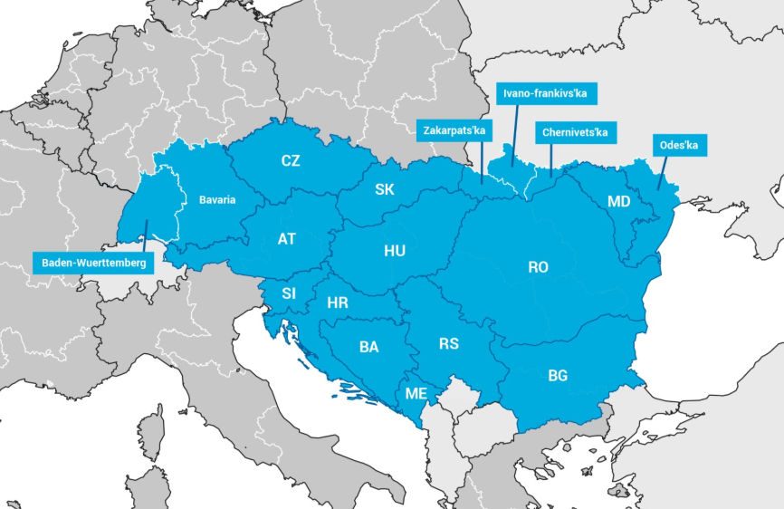
Relevant Funding Programmes - Region & Stakeholder
Interreg
Europe for Citizens
Horizon 2020
ERASMUS
LEADER
ERDF
ESF
...

Slide 12


Slide 13
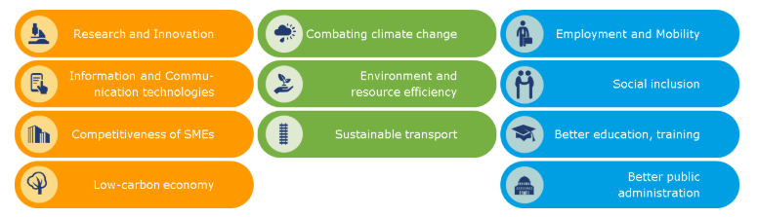
Interreg V (2014 - 2020)
Financed by the European Regional Development Fund (ERDF)
Aims at European Territorial Cooperation
Different "Strands" (Interreg A, B & C)
Focus on 11 investment priorities contributing to the Europe 2020 strategy for smart, sustainable and inclusive growth
Notes:
Interreg V-A, along 38 internal EU borders
Interreg V-B, covering larger areas of co-operation such as the Baltic Sea, Alpine and Mediterranean regions, as well as some non-EU countries.
Interreg V-C, interregional co-operation programme, INTERREG Europe, and 3 networking programmes (Urbact III, Interact III and ESPON). They provide a framework for exchanging experience between regional and local bodies in different countries.
INTERREG I (1990-1993)
INTERREG II (1994-1999)
INTERREG III (2000-2006)
INTERREG IV (2007-2013)
INTERREG V (2014-2020)
A - Cross-border cooperation
e.g. Interreg Slovakia - Hungary
B - Transnational cooperation
e.g. Interreg Danube Transnational Programme
C - Interregional cooperation
e.g. Interreg Europe, ESPON

Slide 14
Interreg V (2014 - 2020)
Interreg B
Transnational Cooperation
e.g. Interreg Danube Transnational Programme
Interreg C
Interregional Cooperation
e.g. Interreg Europe, URBACT
Interreg A
Cross-border Cooperation
e.g. Interreg Slovakia-Hungary
Notes:
Focus on 11 investment priorities

Slide 15
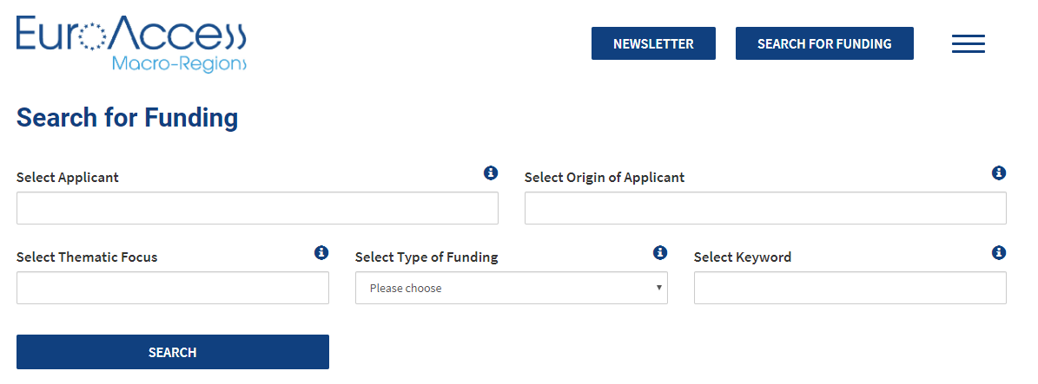
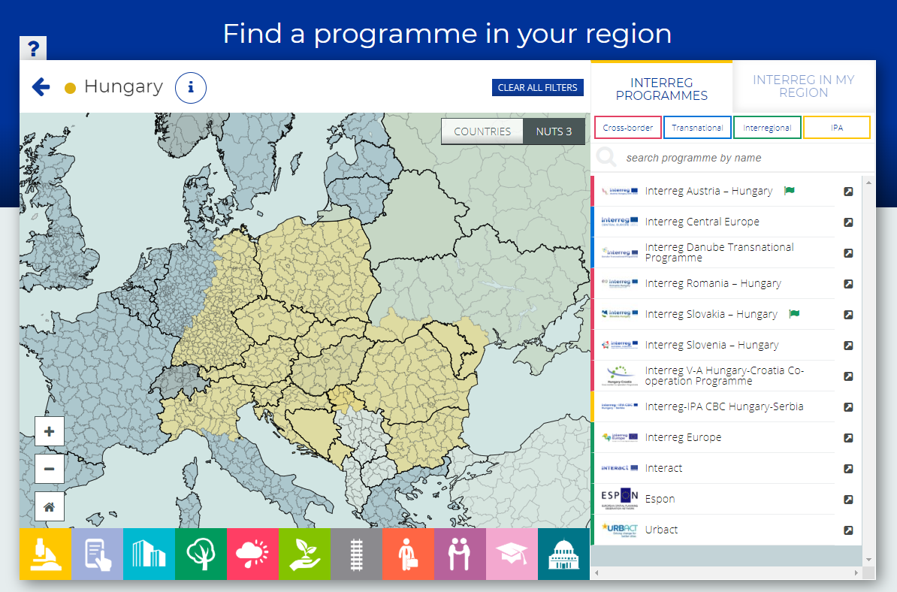
How to find the right Interreg programme for you?
www.euro-access.eu
interreg.eu

Slide 16
Interreg - Who is it for?
EU membership status
Size of organisation (staff, budgets)
Type of project
②
☑
EU member
Big organisations
Project implementation
②
Non-EU member
Small organisations
Type of organisation
Knowledge & capacities


Local/regional authority
High capacities
①
⓪
①
Civil society organisation
⓪
Notes:
Type of organisation (eligible): Education and Training Centres, Federal State / Region / City / Municipality / Local Authority, Research Institution, Lobby Group / Professional Association / Trade Union, Small and Medium Sized Enterprises, SMEs (between 10 and 249 employees), Microenterprises (fewer than 10 employees), NGO / NPO, National Government, University, Enterprise (more than 250 employees or not defined), Association, Public Services, Other

Slide 17
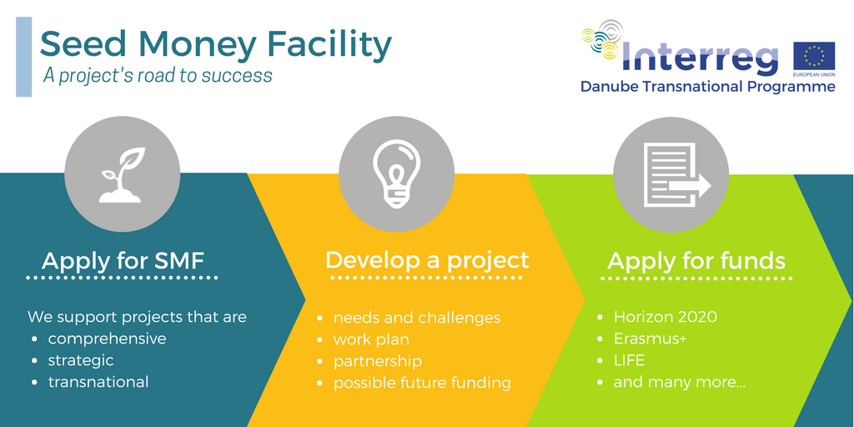
Interreg Danube Transnational Programme Seed Money Facility
Support for the development of complex strategic transnational projects
Proposals must be linked to Priority Areas of the EU Strategy for the Danube Region
Project proposals can be submitted to any available funding: national, mainstream EU, transnational or cross border or by any other public or private investor (such as IFIs) or public-private partnership.
maximum 3 proposals approved per Priority Area
Total budget per project: 50,000.00 EUR (EU contribution to each project is 85% (42,500.00 EUR) for ERDF, IPA and ENI project partner.
Next SMF Call expected to be in the 2nd half of 2020
Disclaimer: Final decisions for the 2nd Call of the DTP SMF by the Monitoring Committee are still pending.
www.interreg-danube.eu/calls/calls-for-proposals/seed-money-facility-call

Slide 18
Interreg DTP Seed Money Facility - Who is it for?
EU membership status
Size of organisation (staff, budgets)
Type of project
②

EU member
Small organisations
Capacity building
Non-EU member


Project preparation
Type of organisation
Knowledge & capacities


Local/regional authority
High capacities
①

⓪
①
Civil society organisation
Low capacities
⓪

Slide 19



Slide 20
Erasmus+ EU Programme for education, training, youth and sport (2014-2020)
Mobility Exchanges
for students, young people
Cooperation Projects
develop, transfer and implement innovative education, training and youth practices
Embracing Sport
support sport events and related partnerships
vocational training students and apprentices,
teachers, youth trainers, ...
boosting employment and entrepreneurship
Funding
Activities

Slide 21
Erasmus+ Programme Information
Key Action 2:
Cooperation for innovation & the exchange of good practices
Key Action 3:
Support for Policy Reform (Youth Dialogue Projects)

Slide 22

Erasmus + Key Action 2: Cooperation for innovation & the exchange of good practices
Strategic Partnerships in the field of education, training and youth
Knowledge Alliances – European Universities
Sector Skills Alliances
Capacity Building in the field of higher education
Capacity Building in the field of youth

Slide 23
Erasmus + Key Action 2: Cooperation for innovation & the exchange of good practices
Strategic Partnerships in the field of education, training and youth
aim to support the development, transfer and/or implementation of innovative practices as well as the implementation of joint initiatives promoting cooperation, peer learning and exchanges of experience at European level.
Horizontal Principles
Acquiring and developing key competences
Social inclusion
Common values, civic engagement and participation
Environmental and climate goals
Innovative practices in a digital era
Supporting educators, youth workers, educational leaders and support staff
Transparency and recognition of skills and qualifications
Sustainable investment, quality and efficiency of education
Social and educational value of European cultural heritage, its contribution to job creation, economic growth and social cohesion

Slide 24
Erasmus + Key Action 2: Cooperation for innovation & the exchange of good practices
Strategic Partnerships in the field of education, training and youth – Project requirements
Eligible organisations
NPO, NGO, entreprises, higher education, public body
Partnership
Min. 2/3 from 2/3 different programme countries
Budget
Up to 450.000 EUR
Contribution vs real costs (75%-100%)
Project duration
6-36 months

Slide 25
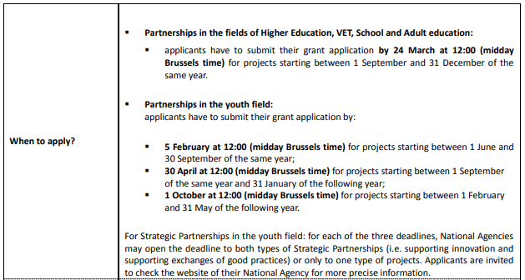
Erasmus + Key Action 2: Cooperation for innovation & the exchange of good practices
Strategic Partnerships in the field of education, training and youth – Calls & Deadlines
© Erasmus+

Slide 26
Erasmus + Key Action 2: Cooperation for innovation & the exchange of good practices
Sector Skills Alliances – Vocational Education and Training (VET)
Project objective
Tackling skills gaps, identifying sector specific labour market needs, demand for new skills
Budget
max. 700.000 EUR (2 years) / max. 1.000.000 EUR (3 years)
Partnership
8 Programme countries / 12 partners
Project duration
2-3 years

Slide 27
Erasmus + Key Action 2: Cooperation for innovation & the exchange of good practices
Capacity Building in the field of youth
Project objective
foster cooperation and exchanges, improve the quality and recognition of youth work, non-formal learning and volunteering
Partnership
3 Programme countries / 3 partners
Project duration
Budget
max. 150.000 EUR

Slide 28
Erasmus + Key Action 2: Cooperation for innovation & the exchange of good practices
Youth Dialogue Projects
Eligible partners: NGO, NPO, Public Body
Partnership
2 partners / 2 countries
Project duration
Budget
max. 50.000 EUR
Promotes active participation of young people in democratic life
Organise events where young people discuss the agreed themes among themselves and with policy-makers, youth experts
and representatives of public authorities to obtain results which are useful for policy-making

Slide 29
Erasmus+ - Who is it for?
EU membership status
Size of organisation (staff, budgets)
Type of project
②

EU member
Big organisations
Capacity building
②

Non-EU member
Small organisations

Project preparation
Type of organisation
Knowledge & capacities


Local/regional authority
High capacities
①

⓪
①
Civil society organisation
Low capacities
⓪
Notes:
https://ec.europa.eu/programmes/erasmus-plus/about/who-can-take-part_en
EU Member States Iceland / Ísland Liechtenstein North Macedonia / Северна Македонија Norway / Norge Turkey / Türkiye
Education and Training Centres, Federal State / Region / City / Municipality / Local Authority, Research Institution, Lobby Group / Professional Association / Trade Union, Small and Medium Sized Enterprises, SMEs (between 10 and 249 employees), Microenterprises (fewer than 10 employees), NGO / NPO, Start Up Company, University, Enterprise (more than 250 employees or not defined), Association, Public Services, Other

Slide 30



Slide 31
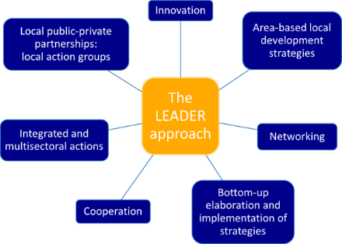
LEADER
Funded by European Agricultural Fund for Rural Development (EAFRD /ELER) & member states and/or provinces.
EU Bottom-up funding programme
Municipalities have to form a "local action group" (LAG) -> region
Legal status
Include civil society
Local development strategy (LDS) describes the projects to be funded over the next 7 years!
Content: Development of the region, economic, ecological, social and cultural aspects of rural living/regional development

Slide 32
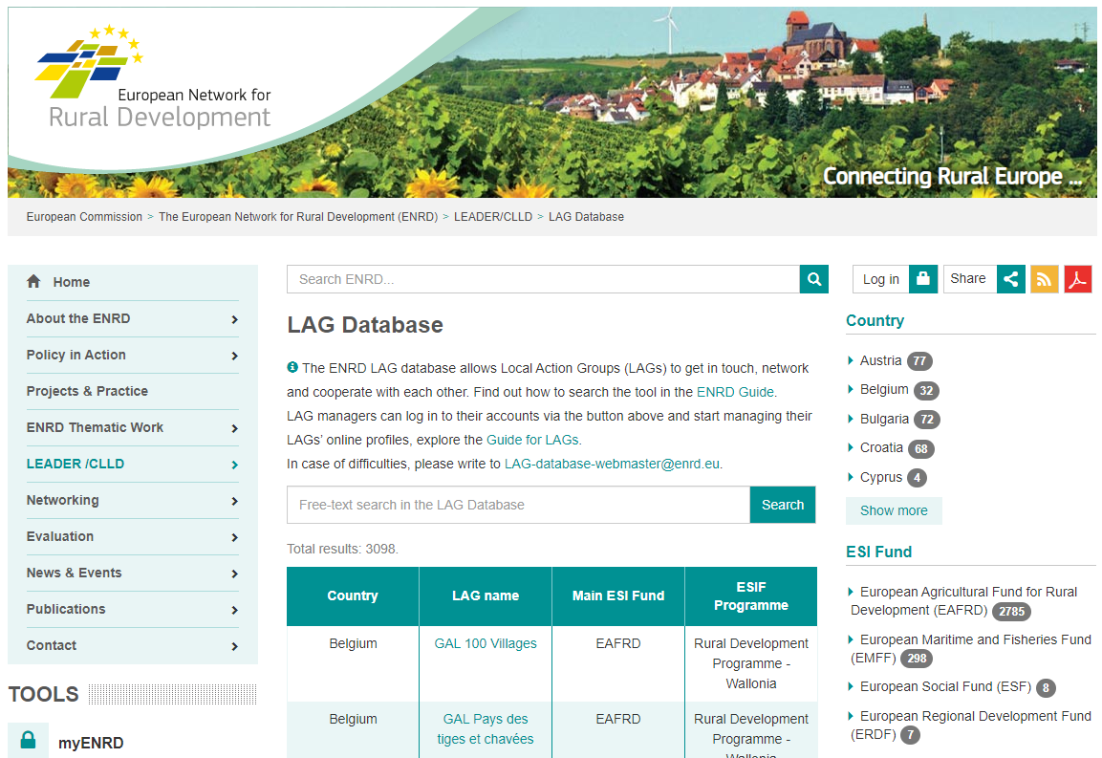
Leader – How to check, if you are a LEADER region
https://enrd.ec.europa.eu/leader-clld/lag-database_en
© European Commission

Slide 33
Leader - Who is it for?
EU membership status
Size of organisation (staff, budgets)
Type of project
②
☑
EU member
Small organisations
Project implementation
Type of organisation
Knowledge & capacities


Local/regional authority
High capacities

Slide 34


Slide 35
Europe for Citizens
Under the overall aim of bringing the Union closer to citizens the general objectives are:
to contribute to citizens' understanding of the Union, its history and diversity;
to foster European citizenship and to improve conditions for civic and democratic participation at Union level.
Europe for Citizens- Strands
Democratic Engagement and Civic Participation
European Remembrance
Operating Grants

Slide 36
Europe for Citizens
European Remembrance
Activities
research, exhibitions, public debates, non-formal education etc.
Aim
Involve citizens from different target groups
Budget
maximum eligible grant for a project is
100 000 EUR
Eligible partners
Public local/
regional bodies, NPOs/CSOs, research org., associations of twinned towns.
Partnership
organisations from at least 1 member state. (trans-national projects
are preferred)
Project duration
maximum project duration is 18 months

Slide 37
Europe for Citizens
Democratic Engagement and Civic Participation
Activities
Initiatives for mutual understanding, intercultural learning, solidarity, societal engagement and volunteering at EU level
Aim
civic participation, focusing in particular on European Union policies
Programmes
Town Twinning/Networks of Towns;
Civil Society Projects
Project duration
Town Twinning:
21 days
Networks of Towns:
24 months
CS projects:
18 months
Eligible partners
Public local/
regional bodies, NPOs/CSOs, research org., associations of twinned towns.
Budget
Town Twinning:
25,000 EUR
Networks of Towns:
150,000 EUR
CS projects:
150,000 EUR

Slide 38
Europe for Citizens
Operating Grants
Aim
raising awareness of European remembrance or encouraging democratic and civic participation
Activities
permanent, usual and regular activities of organisations, with European outreach, contributing to the objectives of the programme
Grant Types
Support for organisations in the form of Framework Partnerships
Project duration
max. 3 years
Eligible partners
CSO for European Remembrance- A, CSO working at EU level - B, European Think Tanks
- C, Platforms of pan-European org. - D
Budget (max. / year)
A: 200,000 EUR
(70% co-financing)
B: 200,000 EUR (70%)
C: 350,000 EUR (70%)
D: 600,000 (90%)

Slide 39
Europe for Citizens - Who is it for?
EU membership status
Size of organisation (staff, budgets)
Type of project
②
☑
EU member
Big organisations
Project implementation
②
Non-EU member
Small organisations
Type of organisation
Knowledge & capacities
①

⓪
①
Civil society organisation
High capacities
⓪


Local/regional authority
Low capacities

Slide 40


Slide 41
Creative Europe
The Creative Europe programme aims to support the European audiovisual, cultural and creative sector.
Creative Europe Strands
Culture
Cooperation projects
Literary translations
European platforms
European networks
Media
Access to market
Online promotion
Film
Video games
Distribution
Cinema
Training
Cross-sectoral
Refugee Integration
Bridging content (digital)

Slide 42
Creative Europe
Culture
Cooperation projects
Media
Festival (Cinema)
Funding rates between 50% - 60 %
Budget per project:
200.000 (smaller scale cooperation projects)
2.000.000 (larger scale cooperation projects)
Eligible partners
Organisations active in the cultural and creative sectors
EU member state / EFRA country
Lump sum
Budget between 19.000 and 75.000
Eligible partners
private companies, non-profit organisations, associations, charities, foundations, municipalities / Town Councils, etc
EU member states / candidate countries / European Neighbourhood policy, etc.

Slide 43
Creative Europe
Cross-sectoral
Refugee Integration
To support cultural, audio-visual and cross-sectorial projects that aim to facilitate the integration of refugees into European communities by fostering respect and understanding for diversity, democratic values and citizenship, intercultural dialogue , tolerance and respect for other cultures.
Project content:
help refugees and migrants socialize
learning platforms
give EU citizens the opportunity to discover, learn from and understand refugees and migrants
support cultural works across Europe
collaboration with organisations in other sectors
Funding rate: 80%
Budget 100.000 - 200.000 EUR
Eligible partners
The project leader and at least one of the partners must be active in the cultural and creative sectors. The additional partners may be active in relevant sectors such as the public, social, healthcare, educational spheres or any other field that could support the integration of refugees.
The Member States of the European Union,
The EFTA/EEA countries: Iceland and Norway,
EU candidate countries: Turkey, Albania, Serbia, Montenegro and North Macedonia,
Potential candidate: Bosnia and Herzegovina

Slide 44
Creative Europe - Who is it for?
EU membership status
Size of organisation (staff, budgets)
Type of project
②
☑
EU member
Big organisations
Project implementation
②
Non-EU member
Small organisations
Type of organisation
Knowledge & capacities
①

⓪
①
Civil society organisation
High capacities
⓪

Low capacities

Slide 45


Slide 46
Horizon 2020 - Overview
© European Commission
Notes:
3 pillars

Slide 47
Horizon 2020 - Overview
Characteristics
Types of Action
Funding Rates
Funding & Tenders

Slide 48
Horizon 2020
Characteristics
Call
Challenge-based
Open to innovative proposals
Less prescriptive
Descriptions allow to propose innovative solutions
Emphasis on impact
Emphasis on innovation
Emphasis on excellence
Support all stages in the research and innovation
Proposal
bring together different disciplines, sectors & actors to tackle specific challenges e.g. scientists, industry, SMEs, end-users ...

Slide 49
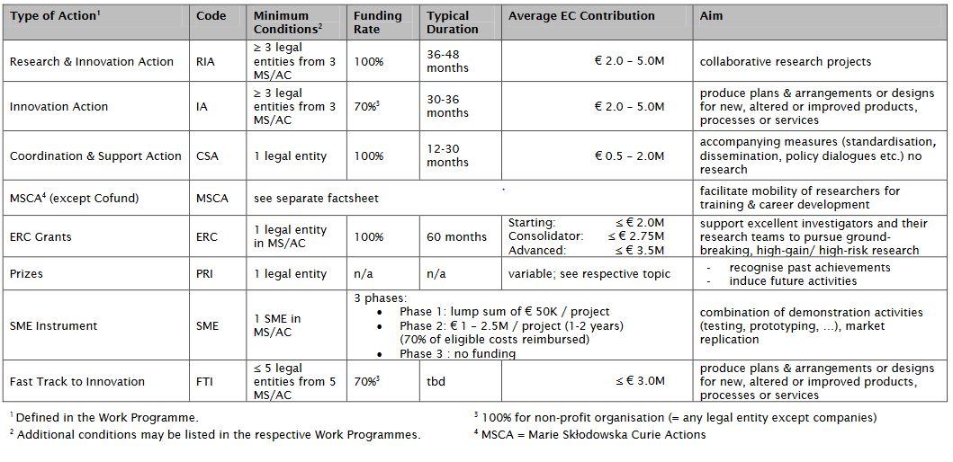
Horizon 2020
Types of Action
© European Commission

Slide 50
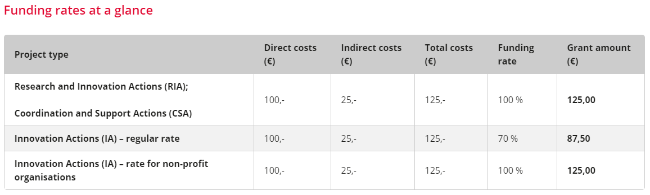
Horizon 2020
Funding Rates
© FFG

Slide 51
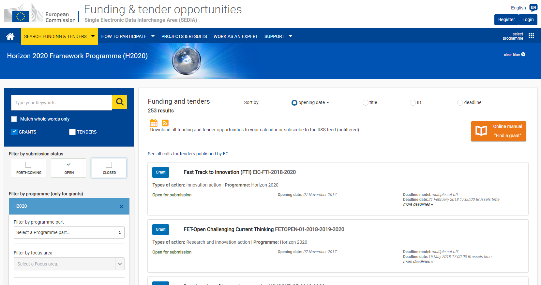
Horizon 2020
Funding & Tenders
© EuroAccess Macro-Regions
www.euro-access.eu
© European Commission

Slide 52
Horizon 2020 - Summary for 2019 & 2020
~ 20 billion Euro "available"
Pilot - blended finance; combination of grant, loan and equity
ERC Synergy Grant
EIC Pilot - Fast Track to Innovation, FET Open, SME Instrument
Open Innovation Testbeds and Digital Innovation Hubs
International Initiatives: China, Canada, Australia, ...
Lump sum funding (simplification)

Slide 53
Horizon 2020- Who is it for?
EU membership status
Size of organisation (staff, budgets)
Type of project
②

EU member
Big organisations
Knowledge exchange
②

Non-EU member
Small organisations
Capacity building
☑
Type of organisation
Knowledge & capacities
Project implementation


Local/regional authority
High capacities
①

⓪
①
Civil society organisation
Low capacities
⓪

Slide 54


Slide 55
European Social Fund (ESF)
Thematic Areas
employment & mobility of employees
fostering social inclusion & fighting poverty
investment in education, training, and lifelong learning
improvement of institutional capacities
Eligible Applicants
Public organizations and private Organizations – no private Persons
Calls
Announced at national (regional) level
Co-financing rate
Up to 50%

Slide 56
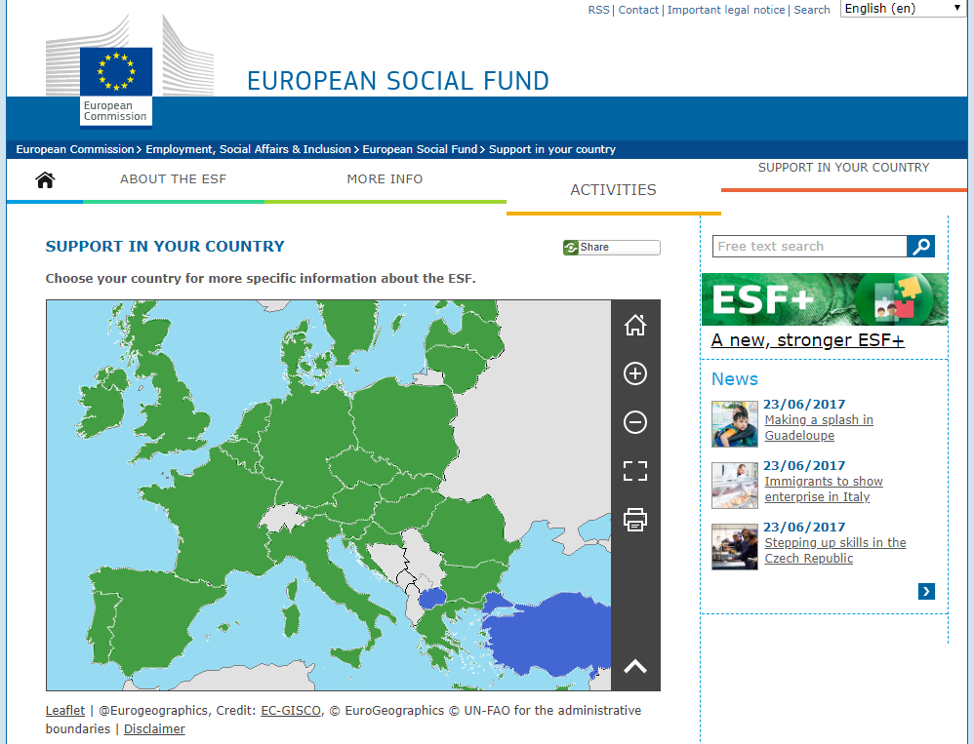
ESF – How to find Calls and my Contact Point?
https://ec.europa.eu/esf/main.jsp?catId=45&langId=en
© European Commission
© European Commission
© EuroAccess Macro-Regions

Slide 57
ESF - Who is it for?
EU membership status
Size of organisation (staff, budgets)
Type of project
②

EU member
Big organisations
Capacity building
②
☑
Non-EU member
Small organisations
Project implementation
Type of organisation
Knowledge & capacities


Local/regional authority
High capacities
①

⓪
①
Civil society organisation
Low capacities
⓪

Slide 58
Development Cooperation

Slide 59


Slide 60

BACID - Building Administrative Capacities in the Danube Region
Support for
small actions of exchange of knowledge between Austrian entities and partners in the countries of the Western Balkans and the Republic of Moldova.
Eligible Partners
The applicant has to be registered in Austria/target country.
The project has to have a Partner from the target country and from Austria.
Managed by
Austrian Association of Cities and Towns (AACT) and KDZ (Public Administration Research Center)
Financing Institution
Austrian Development Agency (ADA)

Slide 61
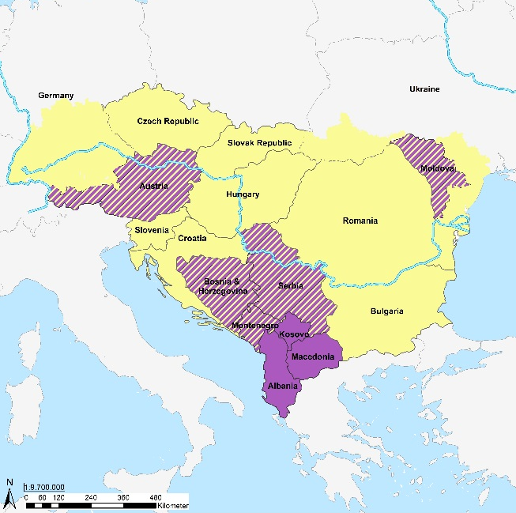
BACID - Building Administrative Capacities in the Danube Region
© BACID
Eligibility of activities
Expert support and mentoring;
Workshops, seminars and training;
Reports, studies, surveys and other documents (e.g. guidance, roadmap, model decision, etc)
Eligibility of costs
max. 10.000 EUR / 6.000 EUR
expert fees
expert per diems
expert travel costs
organisation costs of events.
Eligibility of location
Eligibility of location
© BACID

Slide 62
BACID - Who is it for?
EU membership status
Size of organisation (staff, budgets)
Type of project
②

EU member
Small organisations
Capacity building

Non-EU member
Knowledge exchange

Type of organisation
Knowledge & capacities

Local/regional authority

Low capacities
①
⓪
①
Civil society organisation
⓪

Slide 63


Slide 64
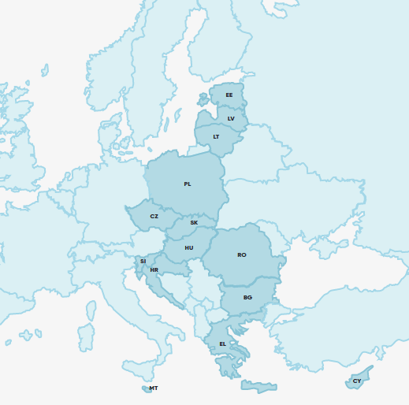
Norway Grants
Innovation, Research, Education and Competitiveness
Environment, Energy, Climate Change and Low Carbon Economy
Calls
Whenever funding becomes available, official calls will be announced.
Open Calls:
https://eeagrants.org/currently-available-funding
Newsletter:
https://us6.list-manage.com/subscribe?u=b0110dcf22f6e47955f26e8dc&id=dcf53ac7d4
How to apply:
https://eeagrants.org/apply-for-funding
Social Inclusion, Youth Employment and Poverty Reduction
Fund for Youth Employment
Fund for Regional Cooperation
Justice and Home Affairs
Culture, Civil Society, Good Governance and Fundamental Rights and Freedoms
Countries
Topics

Slide 65
Norway Grants - Who is it for?
EU membership status
Size of organisation (staff, budgets)
Type of project
②

EU member
Small organisations
Capacity building

Non-EU member
Project preparation
☑
Type of organisation
Knowledge & capacities
Project implementation


Local/regional authority
Low capacities
①
⓪
①
Civil society organisation
⓪

Slide 66
Foundations

Slide 67
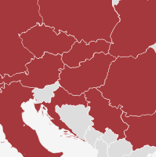



Examples for exploring institutional philantropy for your cause
Foundation Networks can be a useful starting point to identify suitable foundations for your work...
www.efc.be/
www.nef-europe.org
https://dafne-online.eu/

Slide 68
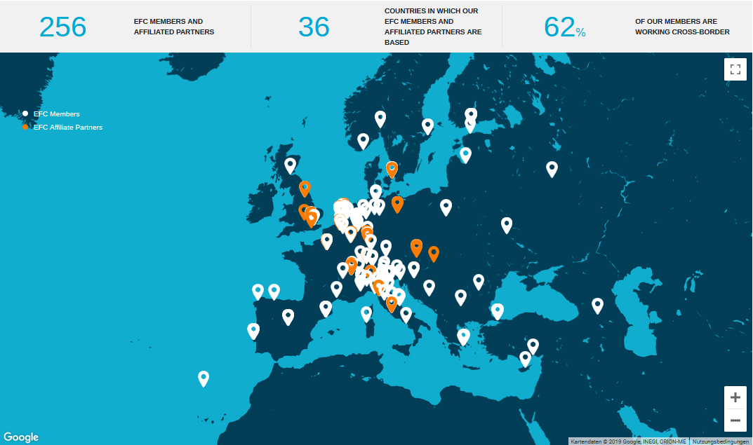
European Foundation Centre (EFC)
As a leading platform for philanthropy in Europe, the EFC works to strengthen the sector and make the case for institutional philanthropy as a formidable means of effecting change.
www.efc.be/thematic-networks/
Diversity, Migration and Integration
Network
Arts and Culture Thematic Network
© EFC
Children’s Thematic Network
Disability Thematic Network
European Foundations for Sustainable Agriculture and Food
European Environmental Funders Group
Funders' Forum on Sustainable Cities
European Democracy Network
Gender Equality Thematic Network
Grantmakers East Forum
Research Forum
www.efc.be/membership/who-are-our-members/
www.efc.be/

Slide 69
Network of European Foundations (NEF)
NEF is a joint-initiative of a small number of foundations. NEF is not a membership-based organisation, but all NEF pooled funds/projects are open to other foundations. Every year NEF works with more than 60 foundations from over 20 countries and various strategic partners in 3 thematic areas.
© EFC
International Development
www.nef-europe.org/international-development/
Social Inclusion
www.nef-europe.org/social-inclusion/
Democracy
www.nef-europe.org/democracy/
www.nef-europe.org

Slide 70
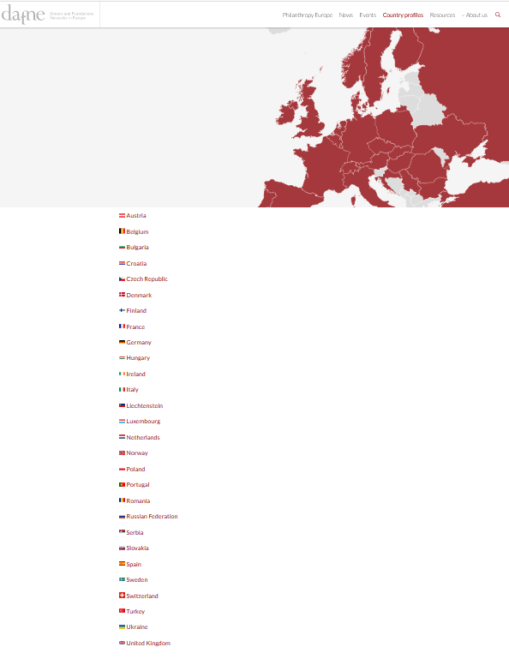
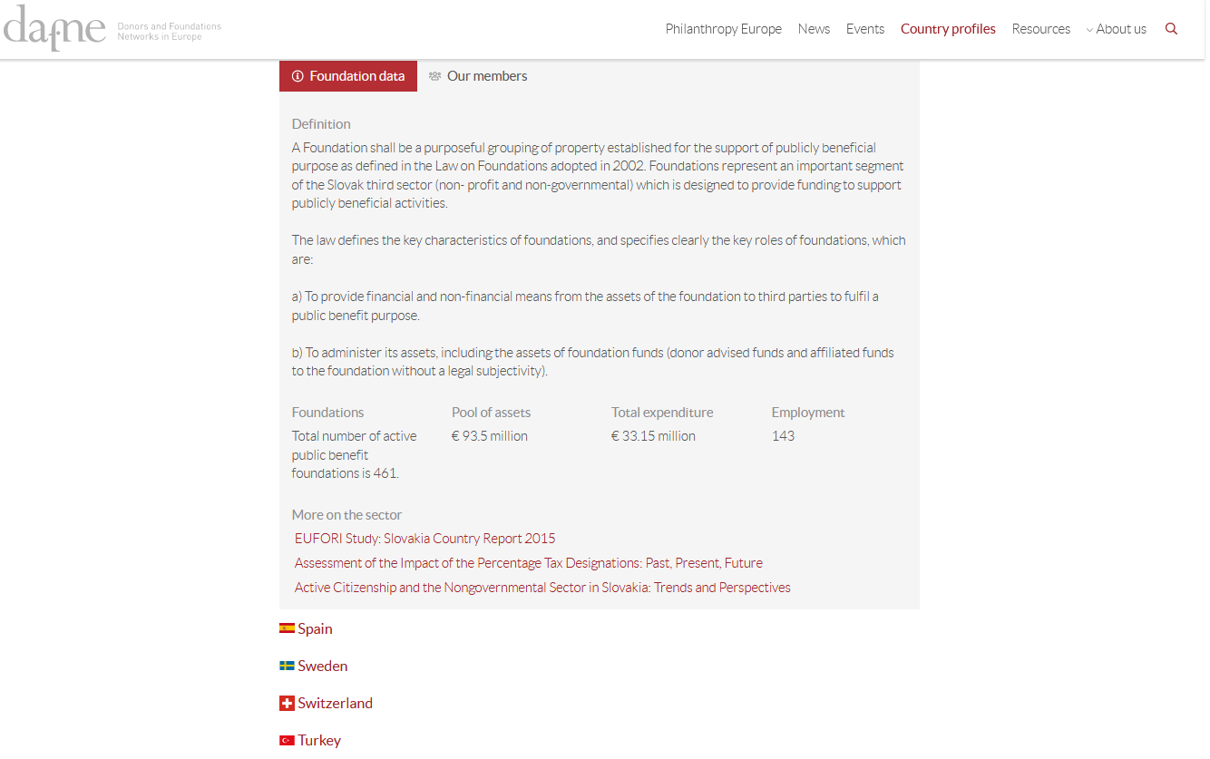
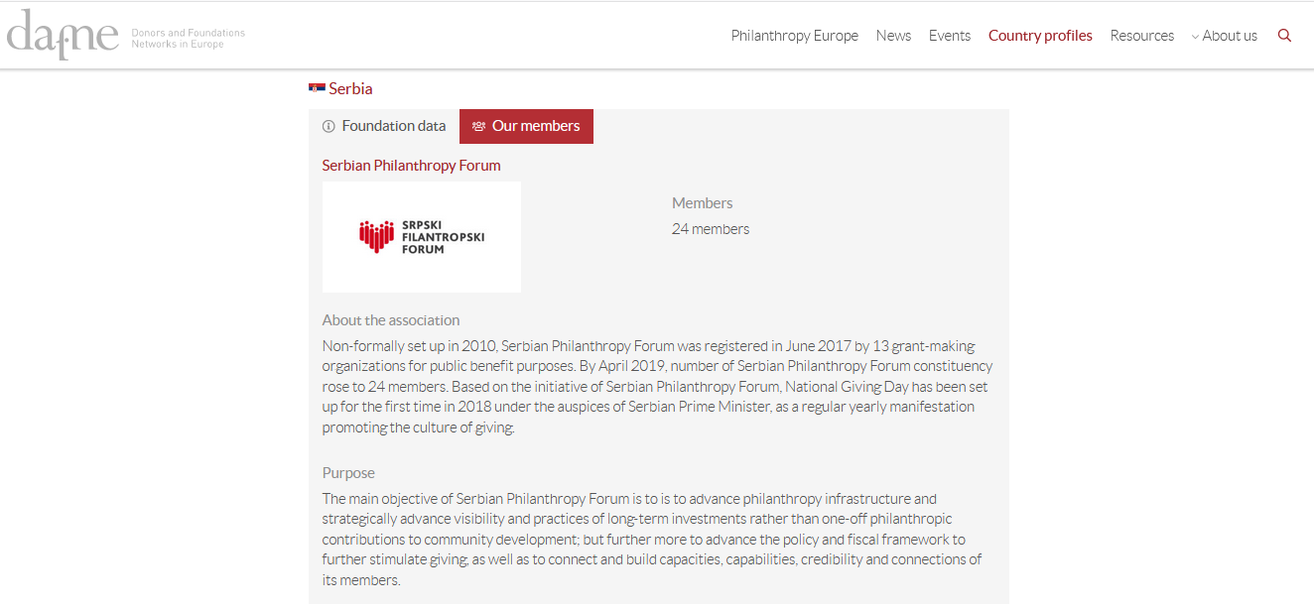
Donors and Foundations Networks in Europe (DAFNE)
Donors and Foundations Networks in Europe (DAFNE) is a network gathering donors and foundations associations in Europe with the aim of providing a platform to share knowledge and learn from best practices. With 30 member associations with a collective membership of more than 10,000 foundations and grant-makers, DAFNE underpins individual activities of its members by encouraging dialogue and collaboration between the national associations.
© EFC
https://dafne-online.eu/country-profiles/
https://dafne-online.eu/

Slide 71
Supporting Tools

Slide 72


Slide 73
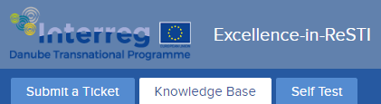
Excellence in ReSTI – Infodesk
© Excellence in ReSTI
Project development
Budget development
Grant Application Writing
Social Innovation
Project Management
Risk Management
Innovation in the business context
Business models
Financial Management and Reporting
EU Policy Goals and Guidelines
Communication and Dissemination and Exploitation
EU 2030 Strategy and beyond
Forming a Consortium
EU Grant Landscape and Funding Structures
Other

Slide 74
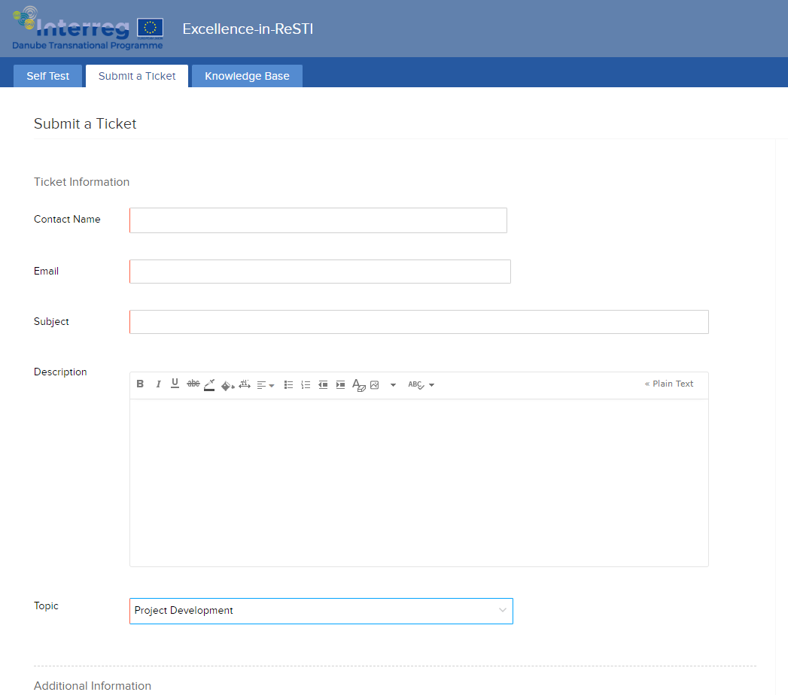
Excellence in ReSTI - Infodesk
© Excellence in ReSTI

Slide 75
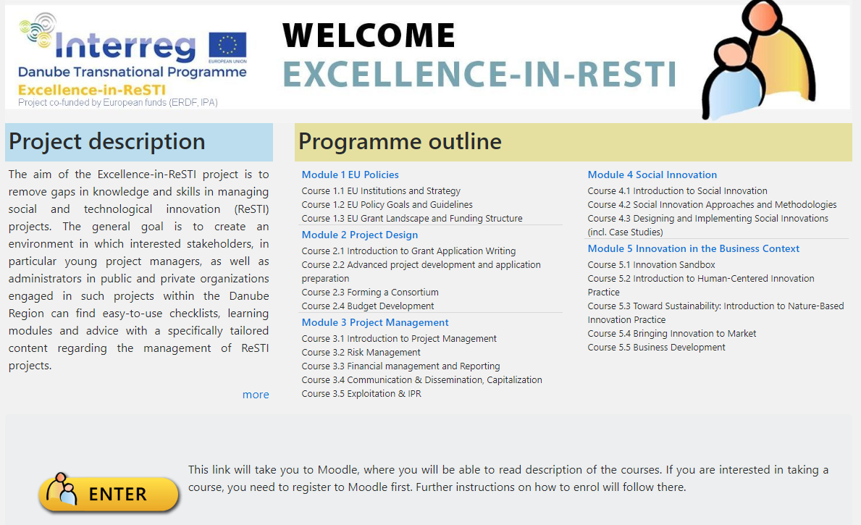
Excellence in ReSTI - Curriculum
© Excellence in ReSTI
ReSTI.Academy
http://resti.academy/

Slide 76


Slide 77
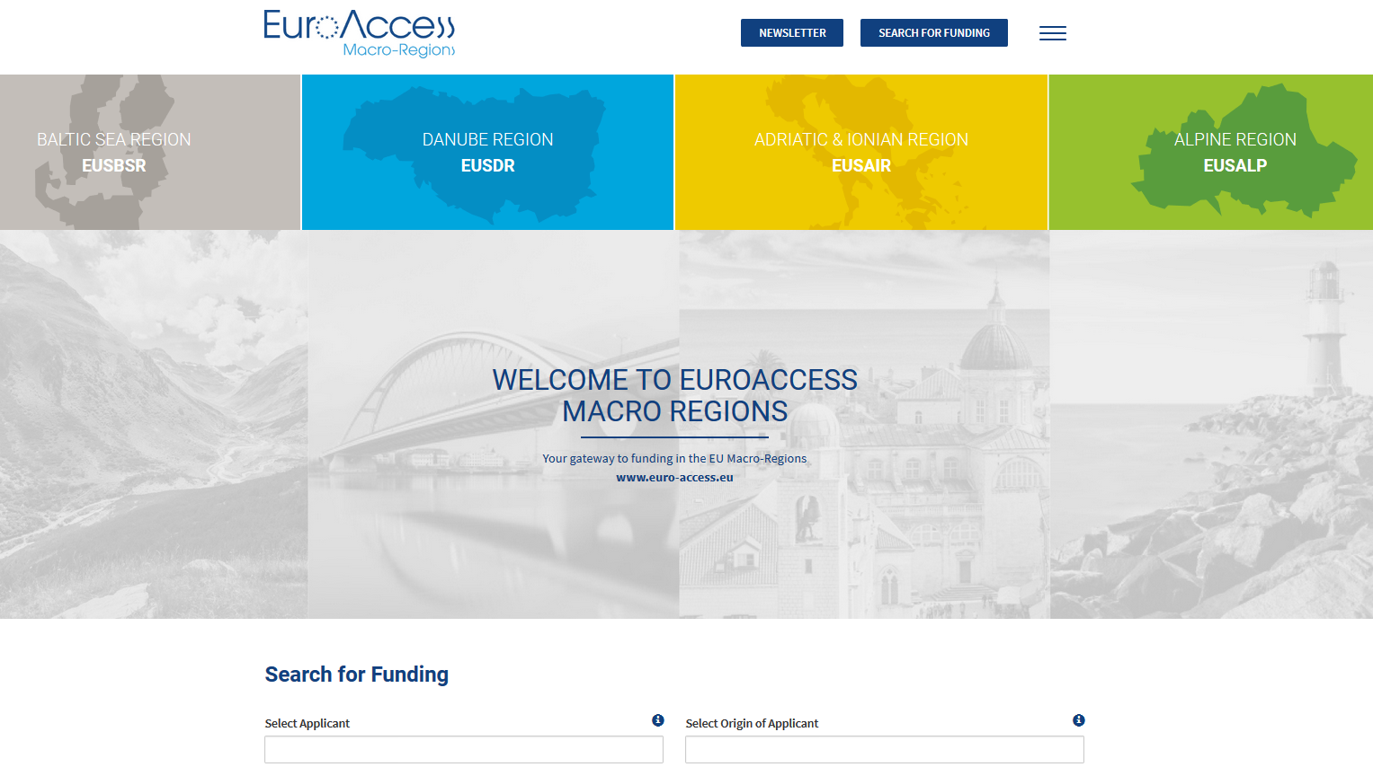
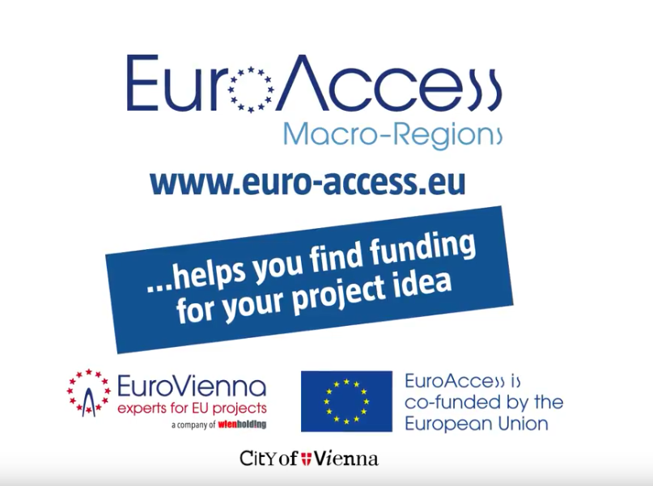

EuroAccess - MacroRegions
© EuroAccess Macro-Regions
www.euro-access.eu/

Slide 78




EuroAccess - MacroRegions
Initiative of EUSDR PA10 Priority Area 10 – Institutional Capacity & Cooperation
Implemented by EuroVienna EU-consulting & -management GmbH www.eurovienna.at
A project financed by the European Union and the City of Vienna

Slide 79
EuroAccess - MacroRegions
What is EuroAccess?
Online search tool for EU funding
Website
Free of charge
English
Who is EuroAccess for?
(Potential) project promoters in the EU Macro-Regions
Different types of organisations
Public bodies, NGOs, universities, SMEs, associations…
Aim:
Support Macro-Regions and their strategic objectives
One-stop-shop for project promoters searching for EU funding for their project ideas

Slide 80




EuroAccess – MacroRegions: What does it offer to you?
Information on 4 Macro-Regions: what, who, where + most relevant funding programmes
Calls for proposals in more than 350 EU funding programmes
Programme information and link
Filters: applicant, origin, thematic focus, macro-region, type of funding, keyword search
Customised newsletter with new calls, tailored to the interest profile of each user
Funding basket to save calls and interesting programmes

Slide 81
From the idea to the proposal

Slide 82
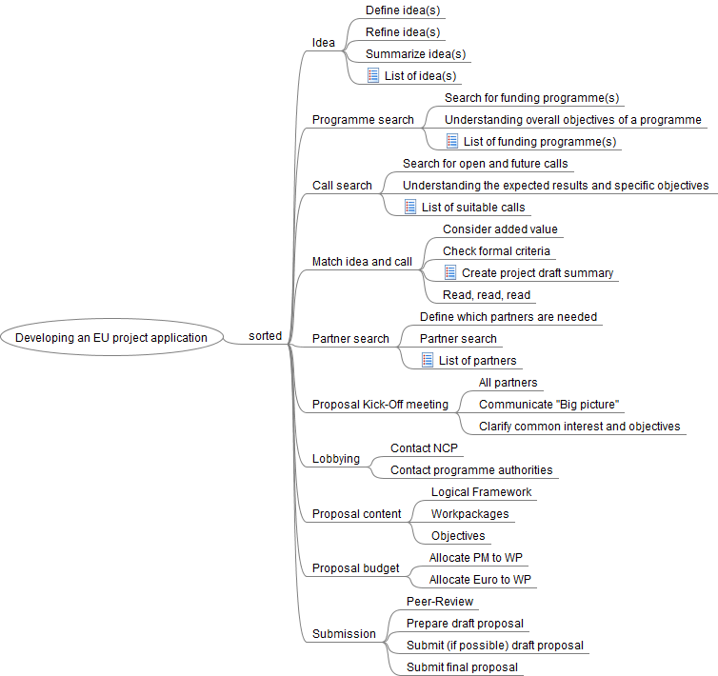
From idea to proposal
Idea
Programme search
Call search
Match idea and call
Partner search
Kick-Off meeting
Lobbying
Proposal content
Proposal budget
Submission
© EuroVienna

Slide 83
From idea to proposal - Idea
Problem vs. Solution
(What do you want to achieve?)
Review your idea from the distance
(Did your problem/idea change?)
Discuss and adopt your idea with others/ Collect input from other sectors
Think of innovative solutions
What is the added value of your idea?

Slide 84
From idea to proposal - Innovation
Develop something new
Solve a problem
First successful realisation
New methods > new problem
New methods > known problem
Idea
Device
Method
Service
Product
…
Known methods > new problem
Known methods > known problem
Commercially successful
Successful policy

Slide 85
From idea to proposal - One page summary
"Finalize" idea - One page summary
Create summary
Include story (Background, Status Quo)
Overall objective > Easy to understand
Visibility of added value for potential partners
Added value of international cooperation
= Business Card of your idea for partner search
Try to define your target group(s)
Try to define the thematic focus of your idea
Budget indication
Partner description
Be open to adapt your idea at later stages!

Slide 86
From idea to proposal - Programme / Call identification
Have a look at the current and upcoming calls
Use search tools to identify calls from other programmes
Identify
Specific objectives / challenge(s)
Expected results / impact
Scope
Evaluation criteria
Keep in mind to look for
Deadlines
Call specific eligibility criteria
Budget available
Cross-cutting Priorities
Download application documents
Read and understand everything
Be prepared to find information that a call may not be suitable with your idea!

Slide 87
From idea to proposal - Programme / Call identification
After understanding the specific requirements of the call!
Stop! Or Go!
Is it possible to match and change your idea?
Contact programme NCP!
Re-Think
Expand and upgrade your idea
Strategies!
Try to identify weak spots (SWOT)
Read the application documents - again and again!

Slide 88
From idea to proposal - Next steps
Meeting with all partners
Clarify main and specific objectives of the project
Agree on main objective(s) of the project
Agree on long-term goals
Try to define main milestones
Try to define WP titles
Try to define responsible LP
Clarify budget needs
Clarify needed additional expertise
Define who is prearing what! -> Proposal
Make sure everybody understands the overall goal of the project!

Slide 89
From idea to proposal - Next steps
Contact the national contact points responsible for the programme
Contact the programme authorities
Identify and participate in events (Applicants seminars, etc.)
To Dos:
Clarify the objectives of your project - again and again
Get as much input and feedback as possible
Be prepared to receive contradictory information
If transnational: ask partners for support
Send proposal draft for feedback - again and again

Slide 90
From idea to proposal - Next steps
Multiple iterations necessary to
finalize Workpackageplan
finalize content of each Workpackage
finalize budget
Make sure to include all documents!
Double check the formal criteria.
Online submission
Submit often - submit early
Don't submit in last minute!
Submission by mail
Read and follow the submission criteria
Send before the deadline

Slide 91


Slide 92
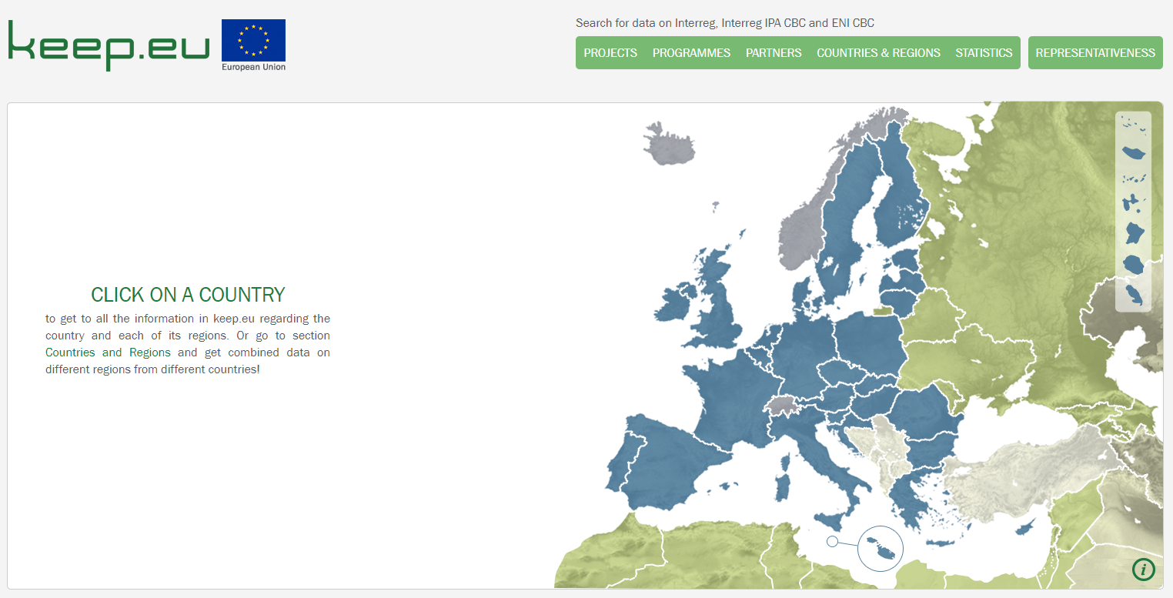
Keep.eu – Capitalise on projects and search for implementers
keep.eu is a database of project related information
Learn more about projects of European Transnational Cooperation (ETC) that were implemented
The content is provided by the programmes themselves or, in the case with macro-regional strategies, by their thematic coordinators.
Learn about projects from
INTERREG,
INTERREG-IPA
ENPI/ENI CROSS-BORDER

Slide 93


Thank you for your participation!
Priority Area 10 Institutional Capacity and Cooperation
Claudia Singer PA10 Coordinator – EUSDR
Claudia.singer@pa10-danube.eu
EuroVienna
Martin Marek Programme Manager
Martin.marek@eurovienna.at

www.danube-capacitycooperation.eu
www.facebook.com/EUSDRPA10/
twitter.com/PA10_EUSDR

